Slide 1




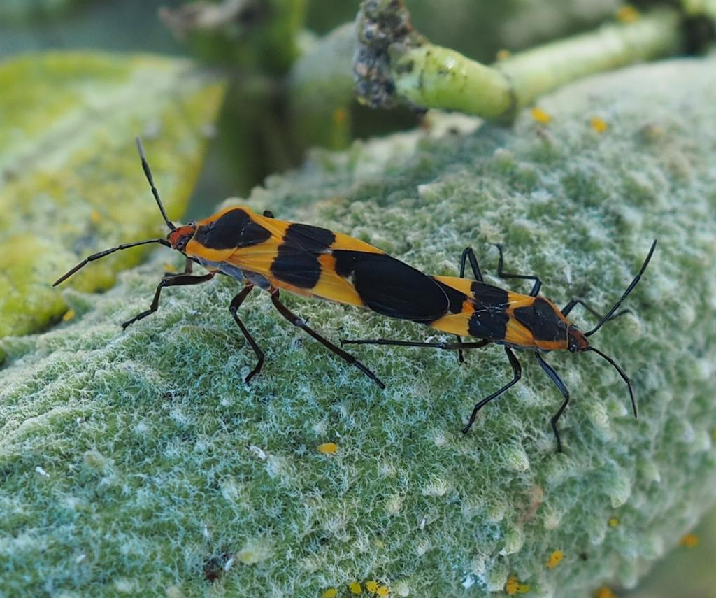
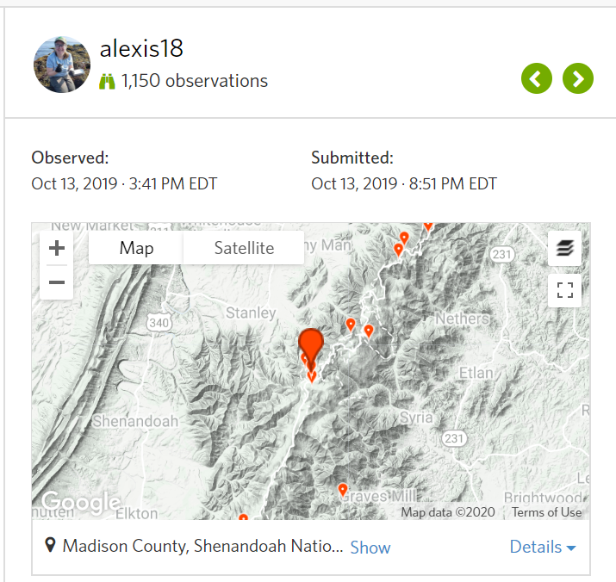
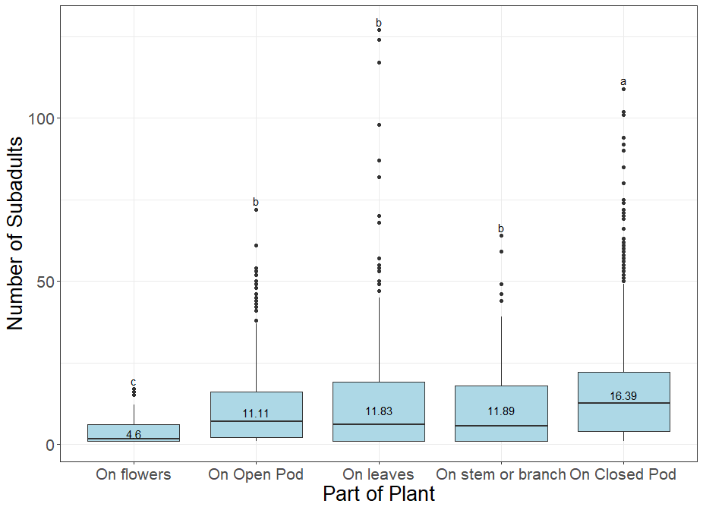
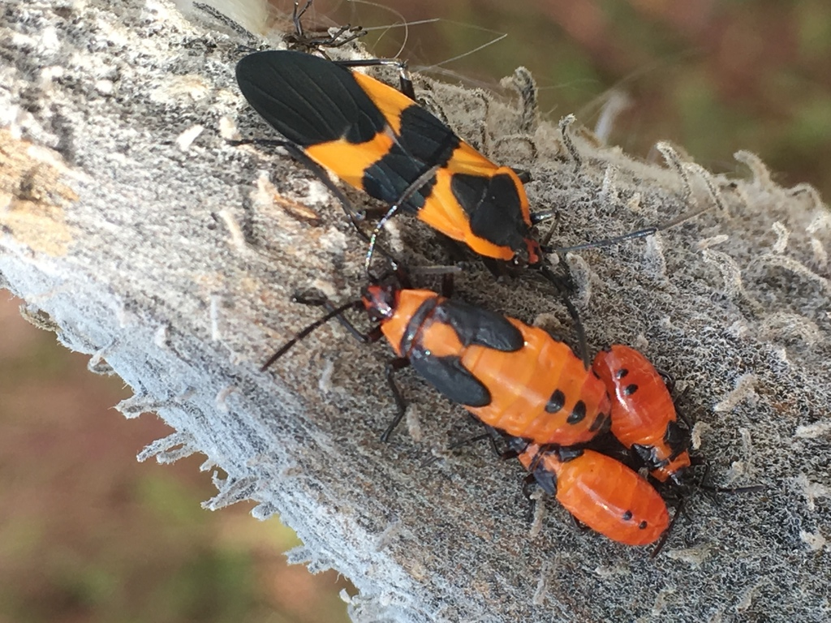
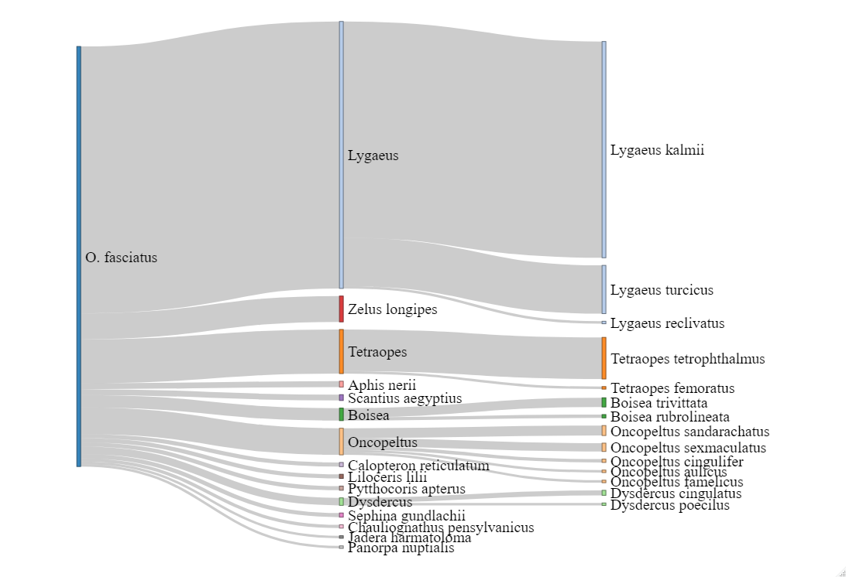
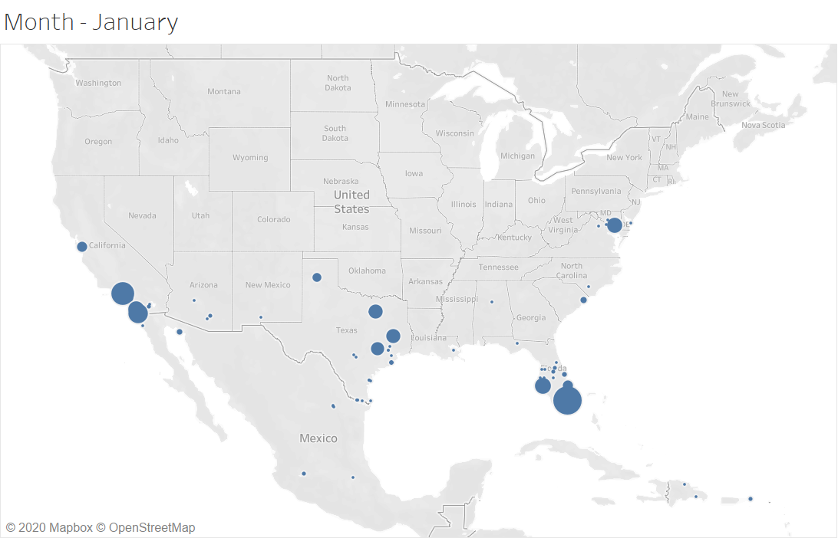
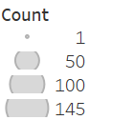
Extracting life stage and behavioral data from observational biodiversity occurrence data reveals spatiotemporal trends in large milkweed bugs
Alexis Garretson, Tedra Cuddy, Rebecca E Forkner,
Department of Biology, George Mason University
Data Collection
Number of Subadults in Clusters Varies by Part of Plant
Closed Milkweed pod
Mating
One Adult
Three Subadults
Mature milkweed pod
Georeferenced location and date from iNaturalist
Taxon Corectness of O. fasciatus Records
Signatures of Migration and Breeding in Occurance Records
Contact: alexis@garretson.net

Slide 2
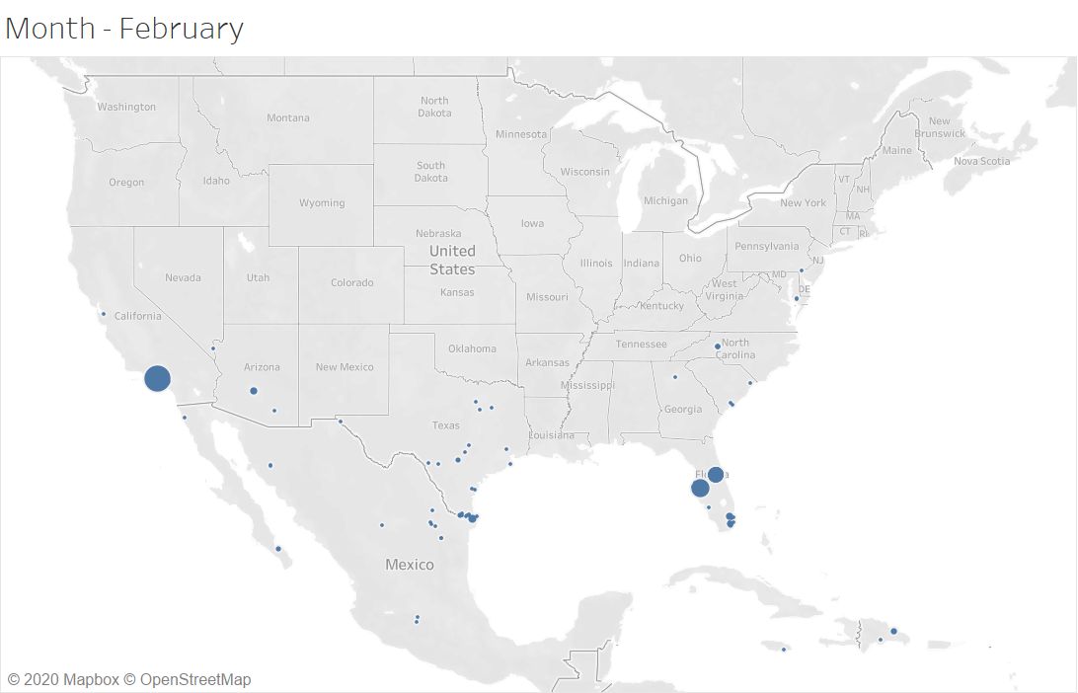
Extracting life stage and behavioral data from observational biodiversity occurrence data reveals spatiotemporal trends in large milkweed bugs
Alexis Garretson, Tedra Cuddy, Rebecca E Forkner,
Department of Biology, George Mason University
Data Collection
Number of Subadults in Clusters Varies by Part of Plant
Closed Milkweed pod
Mating
One Adult
Three Subadults
Mature milkweed pod
Georeferenced location and date from iNaturalist
Taxon Corectness of O. fasciatus Records
Signatures of Migration and Breeding in Occurance Records
Contact: alexis@garretson.net

Slide 3
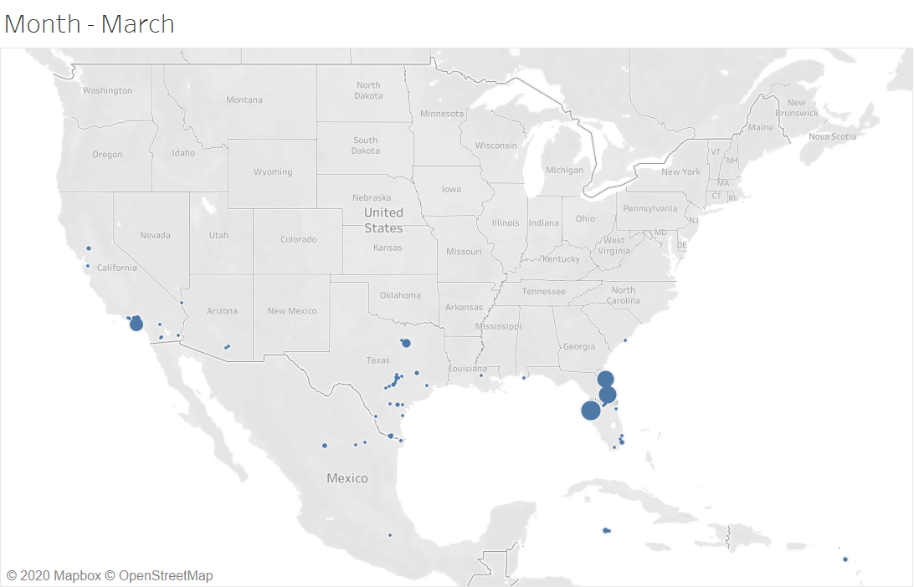
Extracting life stage and behavioral data from observational biodiversity occurrence data reveals spatiotemporal trends in large milkweed bugs
Alexis Garretson, Tedra Cuddy, Rebecca E Forkner,
Department of Biology, George Mason University
Data Collection
Number of Subadults in Clusters Varies by Part of Plant
Closed Milkweed pod
Mating
One Adult
Three Subadults
Mature milkweed pod
Georeferenced location and date from iNaturalist
Taxon Corectness of O. fasciatus Records
Signatures of Migration and Breeding in Occurance Records
Contact: alexis@garretson.net

Slide 4
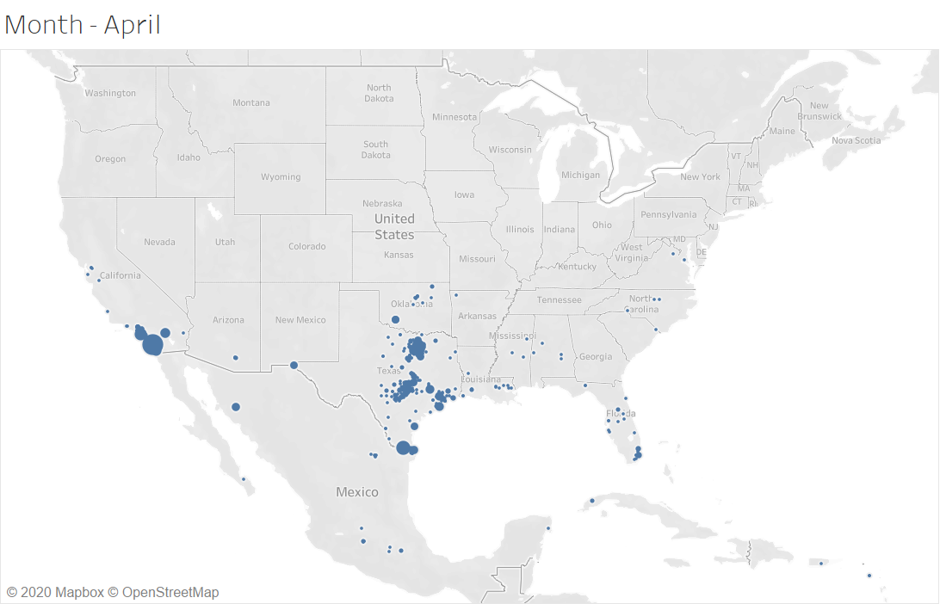
Extracting life stage and behavioral data from observational biodiversity occurrence data reveals spatiotemporal trends in large milkweed bugs
Alexis Garretson, Tedra Cuddy, Rebecca E Forkner,
Department of Biology, George Mason University
Data Collection
Number of Subadults in Clusters Varies by Part of Plant
Closed Milkweed pod
Mating
One Adult
Three Subadults
Mature milkweed pod
Georeferenced location and date from iNaturalist
Taxon Corectness of O. fasciatus Records
Signatures of Migration and Breeding in Occurance Records
Contact: alexis@garretson.net

Slide 5
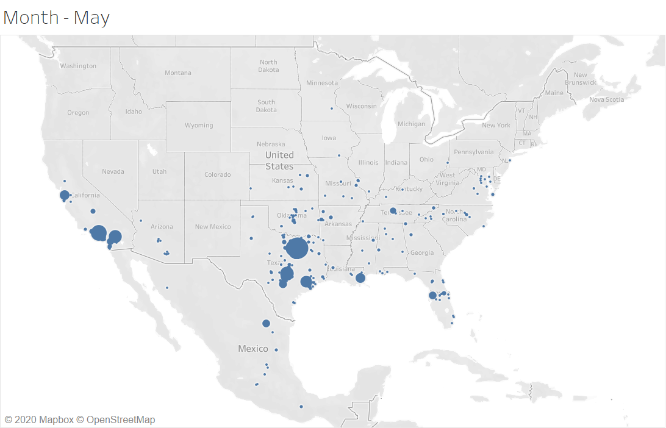
Extracting life stage and behavioral data from observational biodiversity occurrence data reveals spatiotemporal trends in large milkweed bugs
Alexis Garretson, Tedra Cuddy, Rebecca E Forkner,
Department of Biology, George Mason University
Data Collection
Number of Subadults in Clusters Varies by Part of Plant
Closed Milkweed pod
Mating
One Adult
Three Subadults
Mature milkweed pod
Georeferenced location and date from iNaturalist
Taxon Corectness of O. fasciatus Records
Signatures of Migration and Breeding in Occurance Records
Contact: alexis@garretson.net

Slide 6
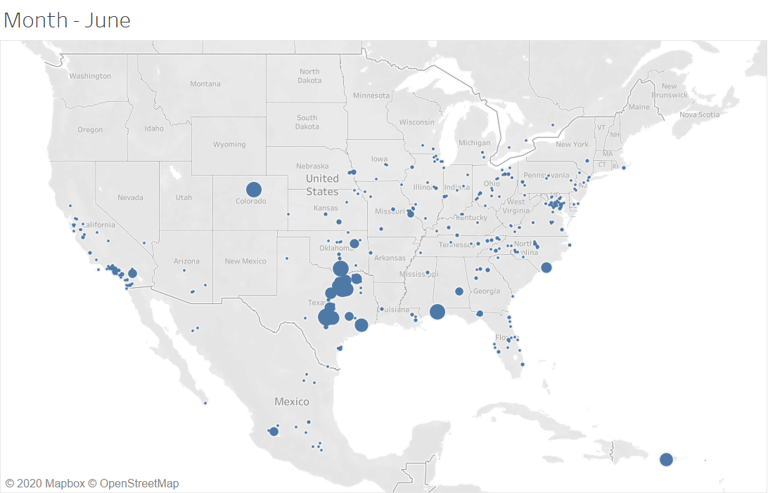
Extracting life stage and behavioral data from observational biodiversity occurrence data reveals spatiotemporal trends in large milkweed bugs
Alexis Garretson, Tedra Cuddy, Rebecca E Forkner,
Department of Biology, George Mason University
Data Collection
Number of Subadults in Clusters Varies by Part of Plant
Closed Milkweed pod
Mating
One Adult
Three Subadults
Mature milkweed pod
Georeferenced location and date from iNaturalist
Taxon Corectness of O. fasciatus Records
Signatures of Migration and Breeding in Occurance Records
Contact: alexis@garretson.net

Slide 7
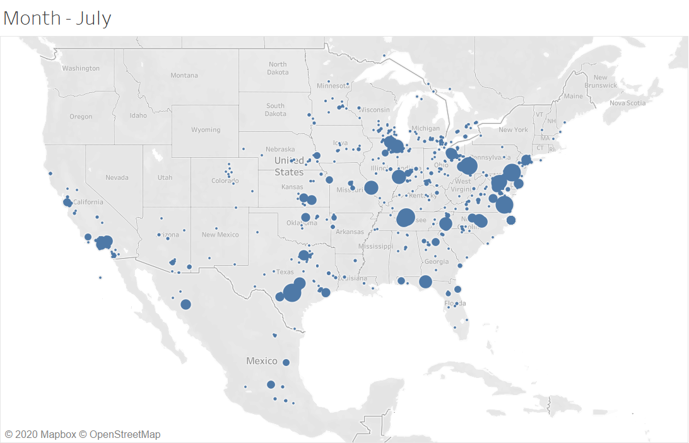
Extracting life stage and behavioral data from observational biodiversity occurrence data reveals spatiotemporal trends in large milkweed bugs
Alexis Garretson, Tedra Cuddy, Rebecca E Forkner,
Department of Biology, George Mason University
Data Collection
Number of Subadults in Clusters Varies by Part of Plant
Closed Milkweed pod
Mating
One Adult
Three Subadults
Mature milkweed pod
Georeferenced location and date from iNaturalist
Taxon Corectness of O. fasciatus Records
Signatures of Migration and Breeding in Occurance Records
Contact: alexis@garretson.net

Slide 8
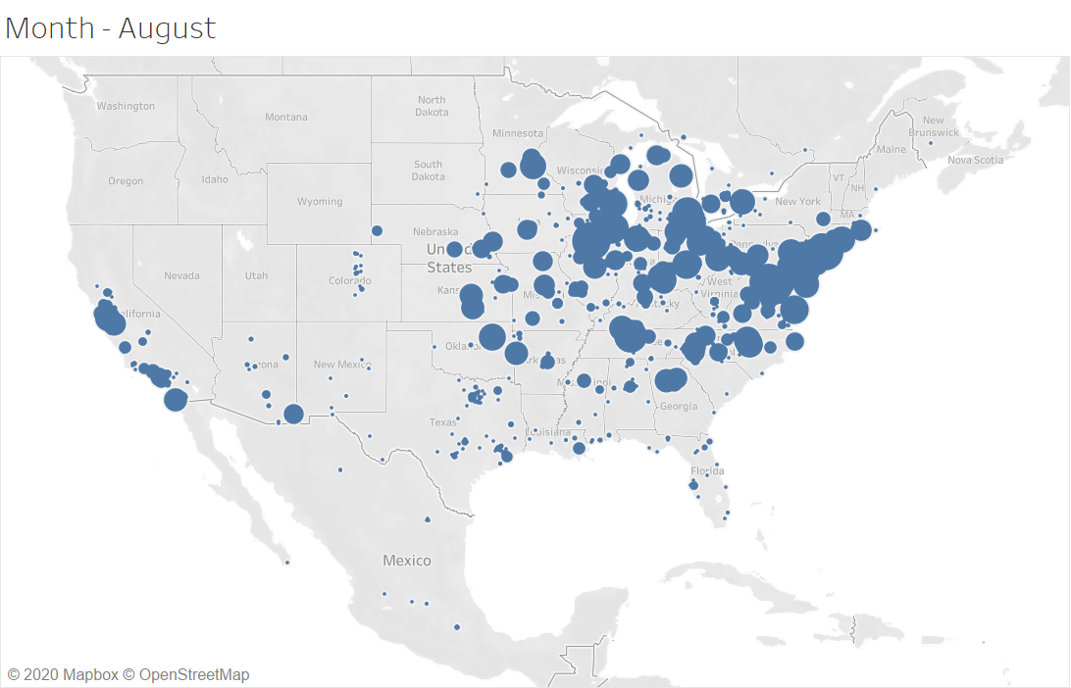
Extracting life stage and behavioral data from observational biodiversity occurrence data reveals spatiotemporal trends in large milkweed bugs
Alexis Garretson, Tedra Cuddy, Rebecca E Forkner,
Department of Biology, George Mason University
Data Collection
Number of Subadults in Clusters Varies by Part of Plant
Closed Milkweed pod
Mating
One Adult
Three Subadults
Mature milkweed pod
Georeferenced location and date from iNaturalist
Taxon Corectness of O. fasciatus Records
Signatures of Migration and Breeding in Occurance Records
Contact: alexis@garretson.net

Slide 9
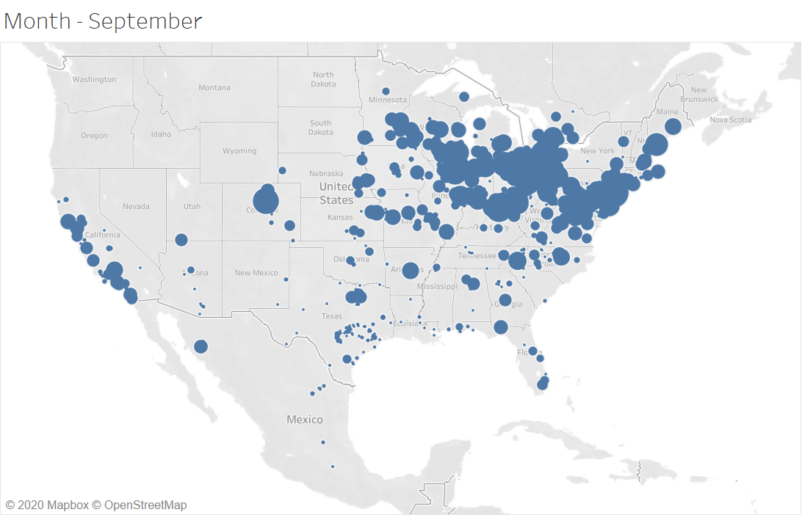
Extracting life stage and behavioral data from observational biodiversity occurrence data reveals spatiotemporal trends in large milkweed bugs
Alexis Garretson, Tedra Cuddy, Rebecca E Forkner,
Department of Biology, George Mason University
Data Collection
Number of Subadults in Clusters Varies by Part of Plant
Closed Milkweed pod
Mating
One Adult
Three Subadults
Mature milkweed pod
Georeferenced location and date from iNaturalist
Taxon Corectness of O. fasciatus Records
Signatures of Migration and Breeding in Occurance Records
Contact: alexis@garretson.net

Slide 10
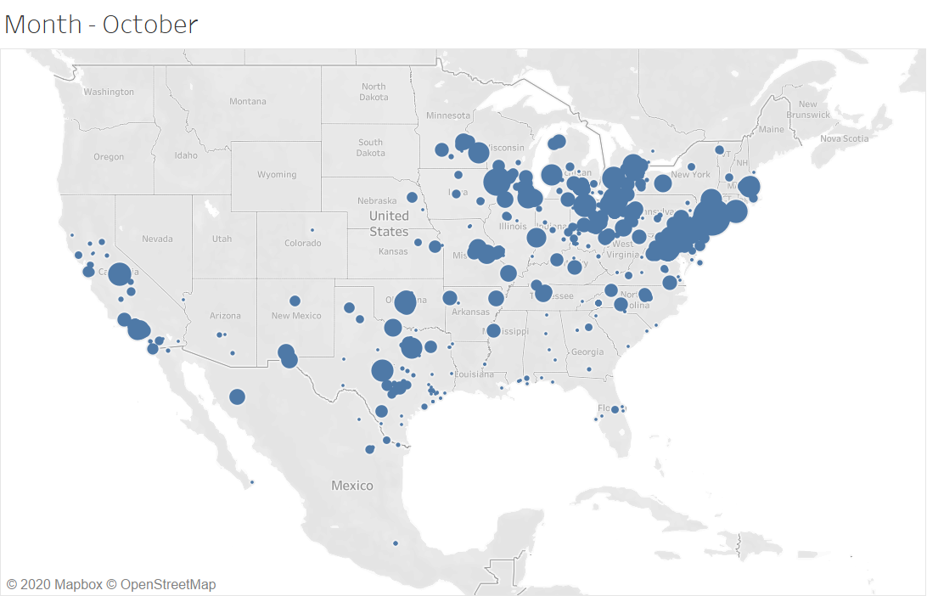
Extracting life stage and behavioral data from observational biodiversity occurrence data reveals spatiotemporal trends in large milkweed bugs
Alexis Garretson, Tedra Cuddy, Rebecca E Forkner,
Department of Biology, George Mason University
Data Collection
Number of Subadults in Clusters Varies by Part of Plant
Closed Milkweed pod
Mating
One Adult
Three Subadults
Mature milkweed pod
Georeferenced location and date from iNaturalist
Taxon Corectness of O. fasciatus Records
Signatures of Migration and Breeding in Occurance Records
Contact: alexis@garretson.net

Slide 11
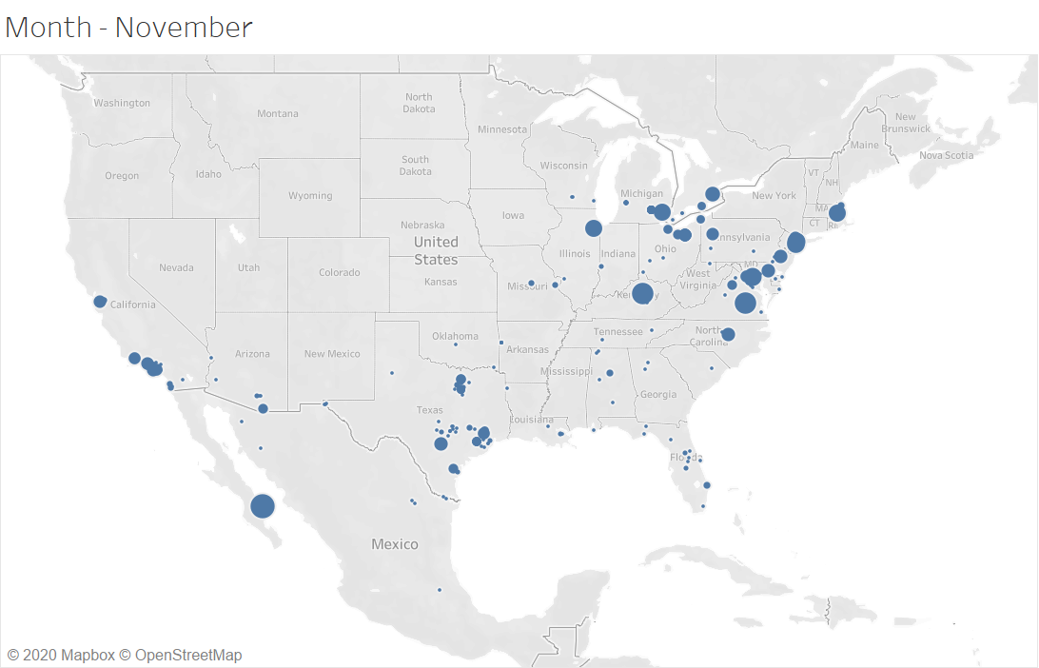
Extracting life stage and behavioral data from observational biodiversity occurrence data reveals spatiotemporal trends in large milkweed bugs
Alexis Garretson, Tedra Cuddy, Rebecca E Forkner,
Department of Biology, George Mason University
Data Collection
Number of Subadults in Clusters Varies by Part of Plant
Closed Milkweed pod
Mating
One Adult
Three Subadults
Mature milkweed pod
Georeferenced location and date from iNaturalist
Taxon Corectness of O. fasciatus Records
Signatures of Migration and Breeding in Occurance Records
Contact: alexis@garretson.net

Slide 12
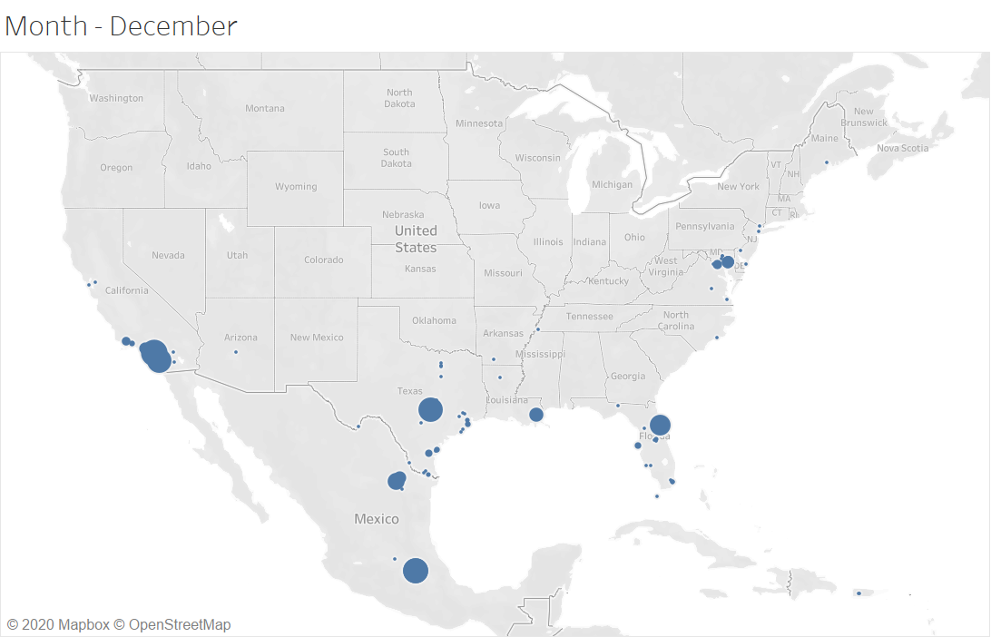
Extracting life stage and behavioral data from observational biodiversity occurrence data reveals spatiotemporal trends in large milkweed bugs
Alexis Garretson, Tedra Cuddy, Rebecca E Forkner,
Department of Biology, George Mason University
Data Collection
Number of Subadults in Clusters Varies by Part of Plant
Closed Milkweed pod
Mating
One Adult
Three Subadults
Mature milkweed pod
Georeferenced location and date from iNaturalist
Taxon Corectness of O. fasciatus Records
Signatures of Migration and Breeding in Occurance Records
Contact: alexis@garretson.net

